Slide 1
Training Experience presentation
Khamis Mushayt General Hospital
2024-1446

Slide 2
Introduction
The training program at Khamis Mushayt General Hospital provided an in-depth experience in the hospital’s IT operations and support functions.
My main responsibilities included printing patient test results and managing blood sample reception using a barcode scanner.
This hands-on training was pivotal in applying theoretical knowledge to real-world medical IT tasks.
This experience was highly relevant to my field of study in computer science, offering valuable practical experience in a professional healthcare environment.

Slide 3
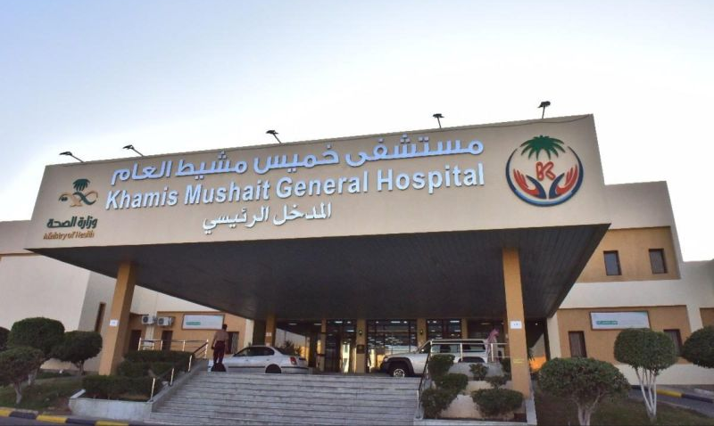
Definition of the Training Entity
Khamis Mushayt General Hospital, located in Khamis Mushayt, Saudi Arabia.
Khamis Mushayt General Hospital is a prominent healthcare facility dedicated to providing high-quality medical services to the community.
The hospital focuses on delivering comprehensive patient care, including diagnostics, treatment, and follow-up services across various medical specialties.
The hospital’s activities encompass a wide range of healthcare services, supported by robust IT systems to manage patient information and streamline medical processes.

Slide 4
Training Mechanism
Structured Training Sessions: Organized into weekly segments focusing on specific IT tasks.
Hands-On Experience: Engaged in daily hospital IT operations and practical tasks.
Tools Used: Barcode scanners for sample tracking and hospital software for data management.
Supervision and Feedback: Regular guidance and evaluations from supervisors to track progress.
The training was structured into weekly sessions, providing hands-on experience with tasks like printing test results and managing blood samples. It utilized barcode scanners and hospital software, with regular supervision and feedback to ensure effective learning and application of skills.

Slide 5
Training Objectives
Practical IT Experience: Gain hands-on experience in a healthcare IT setting.
Data Management Skills: Develop skills in processing patient data and managing hospital IT systems.
Workflow Understanding: Learn to apply IT solutions to improve hospital efficiency and support workflows.
The training aimed to provide practical IT experience in a healthcare environment, enhance skills in managing patient data, and understand how IT solutions support hospital operations. The goal was to bridge theoretical knowledge with real-world application and prepare for future IT roles in medical settings.

Slide 6
Training Content (tasks assigned to me as a trainee)
First week: Getting to know the facility's departments and their work with information technology.
Second week: Working on servers, their operating environment and periodic maintenance.
Third week: Working on maintaining devices, printers and scanners.
Fourth week: Working on adding new points and connecting them to the facility's network.
Fifth week: Working on an appointment system and its working mechanism in the facility.
Sixth week: Working on the facility's medical program and making statistics on it
Seventh week: Working on developing programs in cooperation with the employees of the IT programming department.
Eighth week: Working on e-mail and responding to departments within the facility

Slide 7
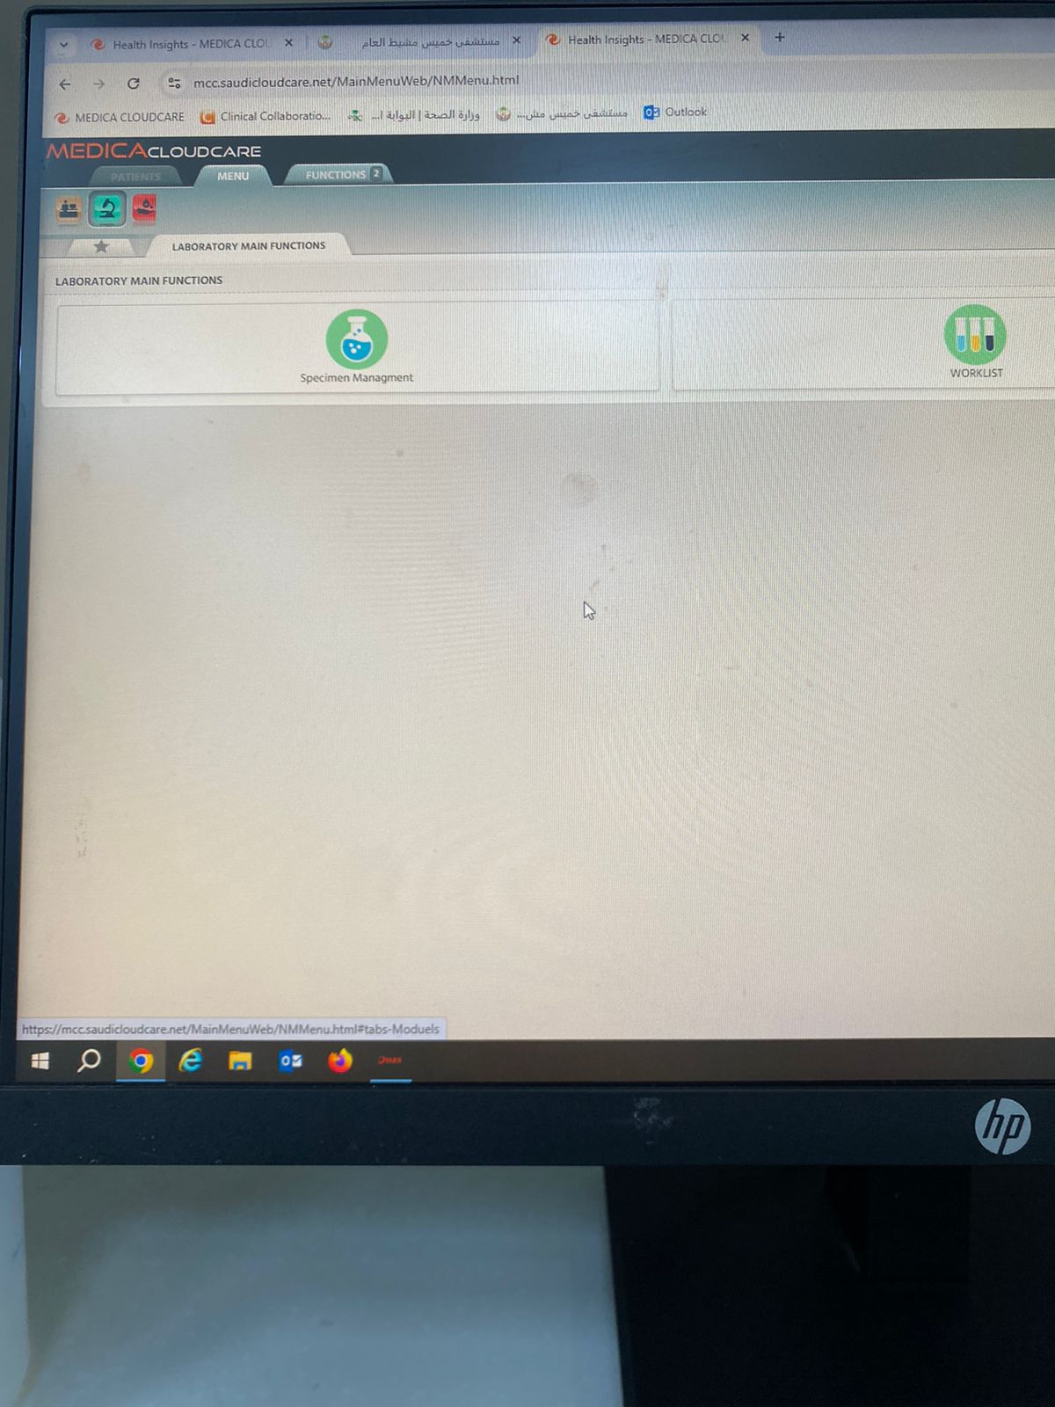
Some pictures from the training
In the first week, i.e. the beginning of the training, I got to know the departments of the facility and their work with information technology

Slide 8
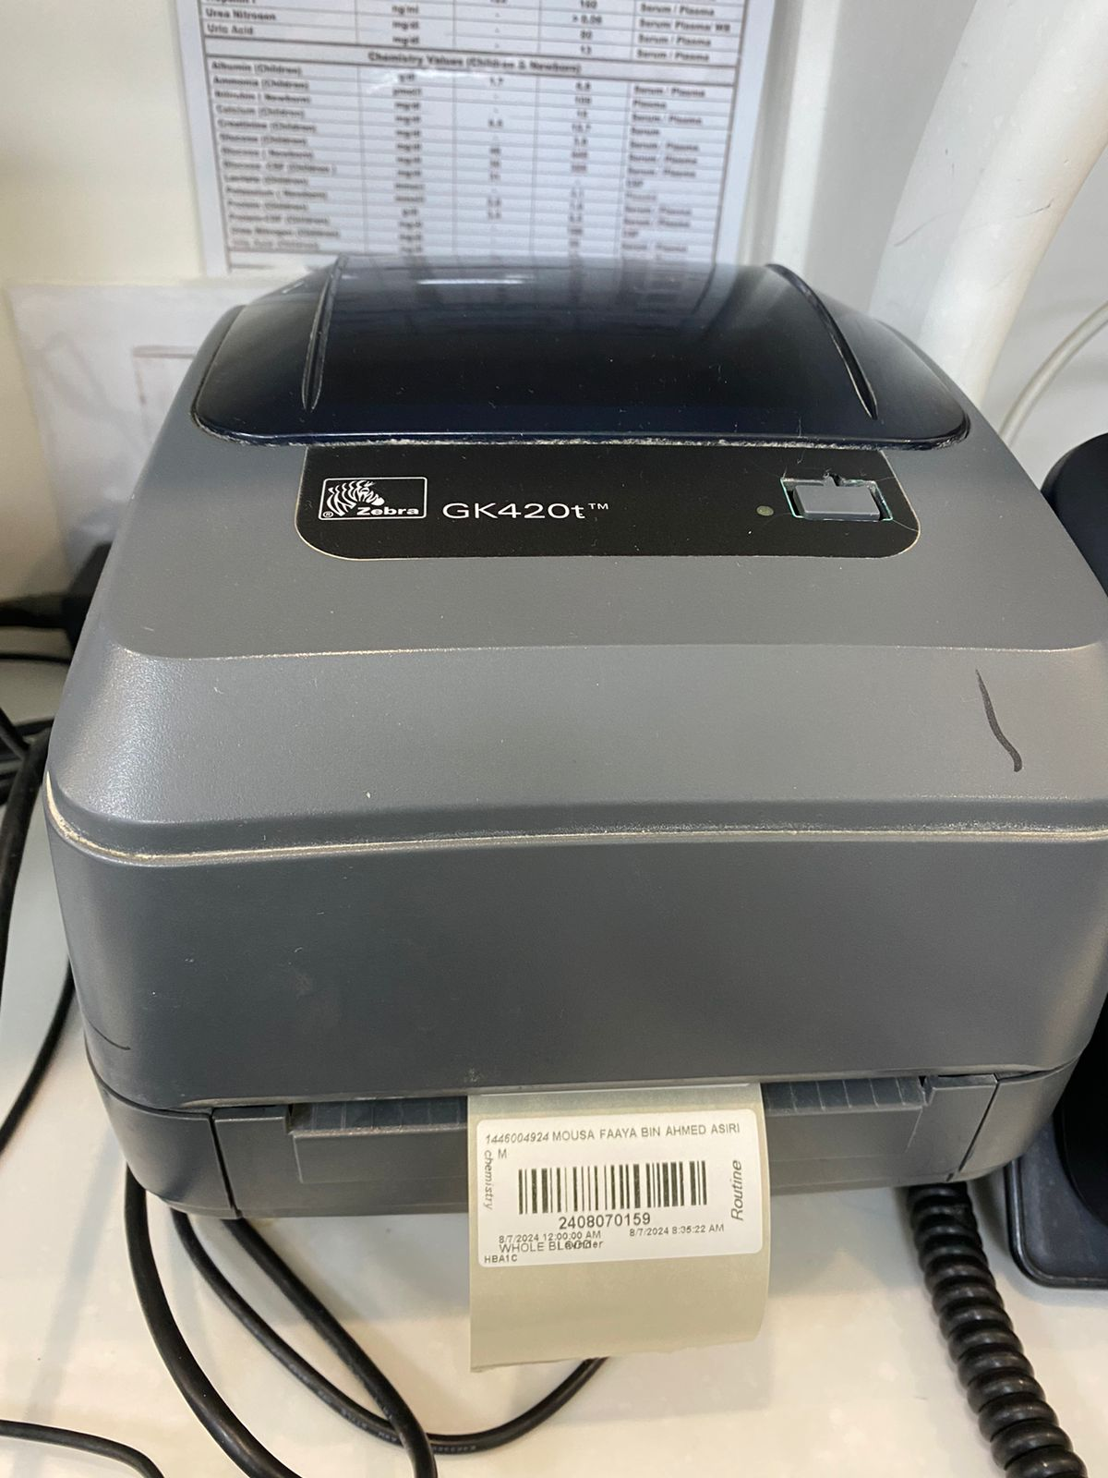
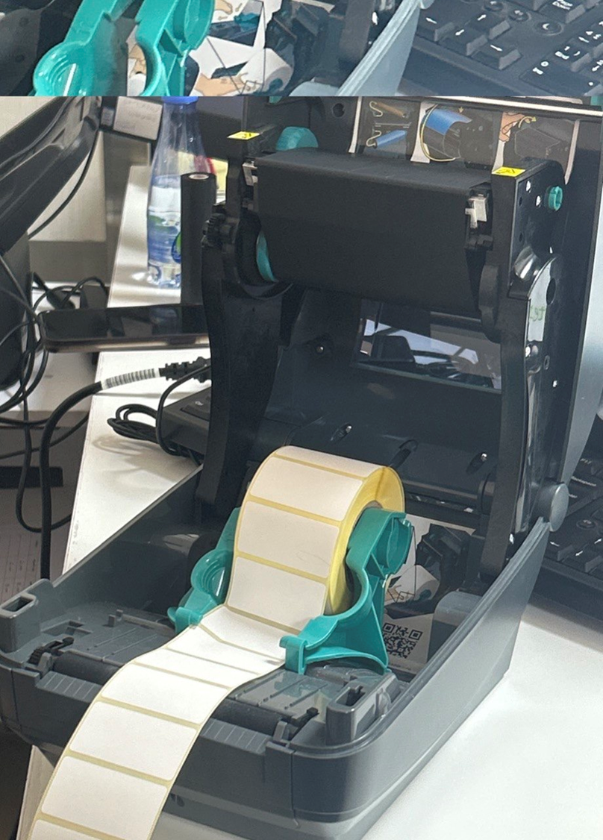
Some pictures from the training
In the third week, I trained on working on maintaining devices, printers and scanners

Slide 9
Acquired Skills
IT System Management: Proficiency in server operations and network expansion.
Device Maintenance: Skills in troubleshooting and maintaining printers and scanners.
Data Management: Experience in handling patient data and generating reports.
Software Development: Collaboration on program development and understanding of hospital-specific software.
Communication: Effective management of email correspondence and inter-departmental communication.

Slide 10
Pros of training
Hands-On Experience: Gained practical skills through real-world tasks.
Comprehensive Learning: Exposure to various aspects of IT in a healthcare setting.
Professional Growth: Enhanced understanding of IT systems and their impact on healthcare.
Benefits and Advantages:
Practical application of theoretical knowledge.
Improved technical and communication skills.
Valuable experience for future roles in IT and healthcare environments.

Slide 11
Cons of training
Challenges Faced:
Technical Difficulties: Encountered issues with hardware and software that required troubleshooting.
Complex Systems: Initial learning curve with hospital-specific IT systems and procedures.
Areas of Improvement:
Training Documentation: More detailed documentation and training materials could help new trainees.
Support Systems: Enhanced support during initial tasks to ease the learning process.

Slide 12
Recommendations for Future Training
Structured Onboarding: Implement a more structured onboarding process for new trainees.
Enhanced Resources: Provide detailed manuals and guides on specific IT systems used in the hospital.
Increased Supervision: Offer more frequent supervision and feedback during initial tasks.

Slide 13
Conclusion
The training experience at Khamis Mushayt General Hospital was highly valuable, offering practical insights into the integration of IT systems within a healthcare setting. Through hands-on tasks such as managing server operations, maintaining devices, and handling patient data, I was able to apply theoretical knowledge in a real-world context. The training significantly contributed to my professional development, preparing me for future roles in IT by providing a comprehensive perspective on the intersection of technology and healthcare.

Slide 14

Thank You
By:
Julia Ali Alahmari
2024-1446

